Slide 1
IBM Data Science Capstone Project
Author: Tan Boon Siong
Date: December 2019

Slide 2
Introduction
Home purchase is one of the most important decisions Singaporeans make in their life. Due to limited land resources, flat prices in Singapore are expensive and flat buyers very often take many years to fully pay off the mortgages tied to the house. Very often, this decision will impact how the individual or family live for the rest of their life.
When purchasing a home, buyers are faced with a wide range of questions and these can be questions on the flat location such as proximity to public transit or questions on the housing development project such as neighbourhood theme and developer reputation.

Slide 3
Problem
Home buyers have many questions to consider and it is often daunting and time consuming to proceed with this enormous task.
This project seeks to assist home buyers with their home purchase by providing more information on the neighbourhood clusters and helping them find their preferred home in the most suitable neighbourhood.

Slide 4
Data – Data Source (1/2)
Foursquare
Foursquare is a technological platform that provides information on a location base.
For this project, Foursquare is used to find out the surrounding amenities of a neighbourhood and the categories of these amenities.
Foursquare is accessed through an API call.
Limitation
The foursquare API is limited by a maximum of 50 returns per API call and limited by a maximum of 950 API calls per day as this project uses a free account. As a result, each neighbourhood only shows 50 venues even though this number can be much larger.
Google Coordinates
Google Search Engine is used to retrieve coordinate data of each neighbourhood. These coordinates are manually stored in a CSV file.

Slide 5
Data – Data Source (2/2)
Singapore Land Authority (SLA)
The SLA provides a free to use data platform called OneMap. OneMap provides a wide variety of population data for each neighbourhood in Singapore. At the point of writing the report, the latest data available is of year 2010 and this is used as an approximate for the clusters.
For the purpose of this project, only data on education, ethnicity, age, religion and industry are used.
OneMap is accessed through an API call.
Wikipedia
Wikipedia is an online encyclopedia that contains vast online of unstructured information. This project leverages the data source and extracts information on neighbourhood population size and neighbourhood land size.
Information from Wikipedia is extracted via HTML.

Slide 6
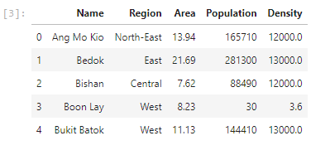
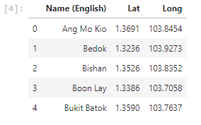
Pre-processing (1/2)
Neighbourhood Data
Neighbourhood data is extracted from Wikipedia via HTML and is stored in a data-frame named “sg_area_table”.
When first extracted, this table contains 9 columns, of which 4 are later dropped. Only “Name”, “Region”, “Area”, “Population”, “Density” columns are kept. Below is a snippet of the data-frame.
Coordinate Data
Coordinate data is extracted from a CSV file and is stored in a data-frame named “coord_table”.
When first extracted, this table list both the latitude and longitude under the same column and this is later separated in the pre-processing process. Below is a snippet of the data-frame.

Slide 7
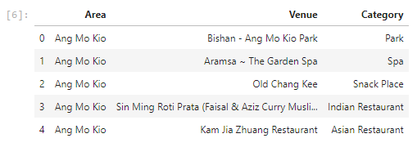
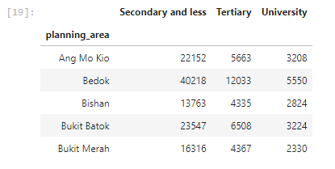
Pre-processing (2/2)
Venue Data
Venue data is extracted from the Foursquare API and is stored in a data-frame named “venue_df”.
The data is collected by iteratively calling the Foursquare API using a list of neighbourhoods and each time the API is called, only the “Area”, “Venue” and “Category” information are selectively chosen to be appended into the data-frame. Below is a snippet of the data-frame.
Population Data
Population data is extracted from OneMap via API call and stored in 5 data-frames, “edu_df”, “ethnic_df”, “ind_df”, “age_df” and “reli_df”.
Information certain demographics may not be available in some neighbourhoods and are therefore excluded from analysis.
Some columns are streamlined for better analysis.

Slide 8
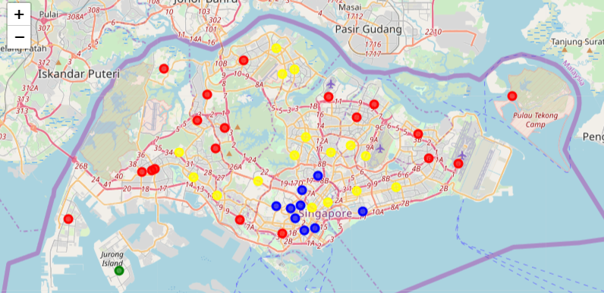
Amenities Clustering (1/2)

Slide 9
Amenities Clustering (2/2)
Top 5 Amenities
Blue: Hotel, Japanese Restaurant, Chinese Restaurant, Bakery, Boutique
Green: Boat or Ferry, Cruise, Coffee Shop, Recreation Center, Beach
Red: Coffee Shop, Park, Café, Chinese Restaurant, Food Court
Yellow: Chinese Restaurant, Ice Cream Shop, Indian Restaurant, Park, Thai Restaurant
Commentary
Neighbourhoods in the southern region are better represented by hotels. Neighbourhoods in the outer parts of the country are better represented by coffee shops and parks while those in the inner parts of the country are better represented by the different restaurant cuisines.
Jurong island is different from the rest of the country and is represented by water transport features.

Slide 10
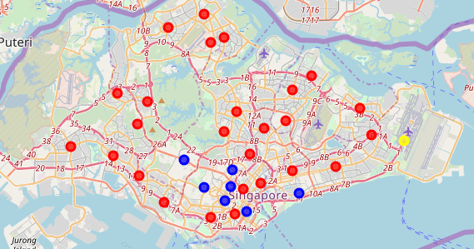
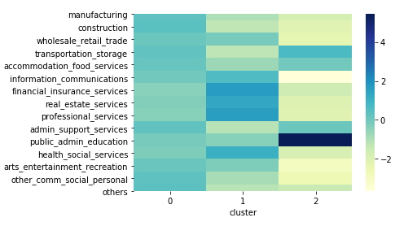
Industry Clustering (1/2)

Slide 11
Industry Clustering (2/2)
Colour Code
Red: 0
Blue: 1
Yellow: 2
Commentaries
Population residing in the southern part of Singapore are more likely to work in the financial, real estate and professional services industry while those residing in Changi are more likely to work in the public, admin and education industry.

Slide 12
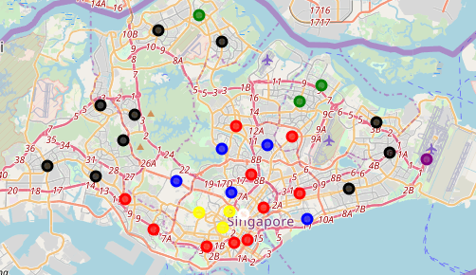
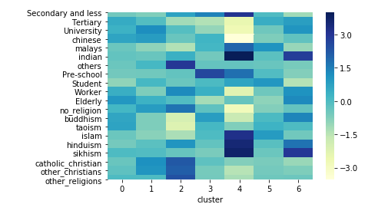
Demographic Clustering (1/2)

Slide 13
Demographic Clustering (2/2)
Colour Code
Red: 0
Blue: 1
Yellow: 2
Green: 3
Purple: 4
Black: 5
White: 6
Commentaries
Population residing in the sub-urban (blue) are more likely to be university educated, Chinese and Christians. Population residing in the Orchard area (yellow) are more likely to be Christians of the non-core races. The North and North-Eastern Outskirts (green) have more preschools. The population in Changi (purple) are more likely to be Malays and Indians. The population in Rocher (White) are more likely to be Indians.

Slide 14
Future Direction
As of writing, the project faces a couple of data limitations namely from Foursquare API and OneMap API.
Foursquare API allows a maximum of 50 rows per call and a total of 950 calls per day, thereby limiting the number of amenities data the project uses.
OneMap does not yet provide up to date data.
Once both of these limitations are removed, there can be room for more relevant and robust data sets, and this would also translate to better insights from the cluster analysis.

Slide 15
Conclusion
There are indeed clear lines and differences among neighbourhood clusters in Singapore and this is now highlighted by aggregating and finding patterns in data from different sources.
While the study concluded that neighbourhood clusters in Singapore differ from one another in amenities, population industries and population demographics, the reader of this report should also take note of the limitations in this study.

